Slide 1

Machine Learning Algorithms for Stock Trading
Group 7
Alexander McMullan
Ahudiya Osiri
Muhammad A Butt
Andrew Lim

Slide 2

Table of Contents
Motivation/Summary Slide
Model Summary
Data Clean up and Model Training
Model Evaluation
Discussion
Postmortem
Questions

Slide 3
Project Summary
Our project is to create a predictive algorithm that uses machine learning to signal buy, sell or hold actions.
To do this, we first sourced historical data for two stocks, which provided us with trading data for Apple(aapl), and Nvidia Corp (nvda) every 30 minutes for the last five years.
We first analyzed the data to bring out the important predictive features and then created a predictive model using the Decision tree. We also fit the data into a cluster analysis and logistic regression model to compare the performance of the models and to determine which has sufficient predictive power.
Given the highly volatile financial market conditions and complex, fast paced stock market trading system where gains or losses to an investment portfolio is based on not only on market analysis, but also on good timing and many right predictions. A probabilistic ML algorithm with very good precision accuracy can be extremely profitable.
Also, unlike many algotrading models that issue per second trading signals, we believe there is much value to capture in a model that focuses on a wider window – every 30minutes –in our case, thereby allowing for more precise prediction of market direction and lower transaction costs.

Slide 4
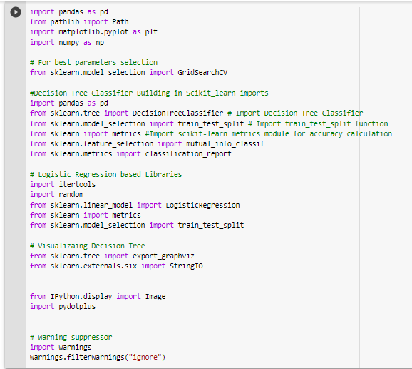
Libraries in Use
We created a notebook on Google Collab.
Imported the following libraries
Pandas
Numpy
SKLearn
Decision Tree Classifier
Logistic Regression
Matplotlib
Pathlib
Pydotplus

Slide 5
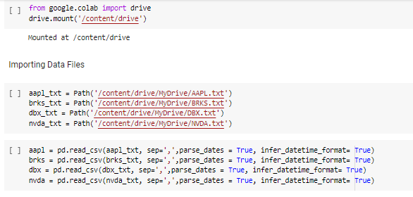
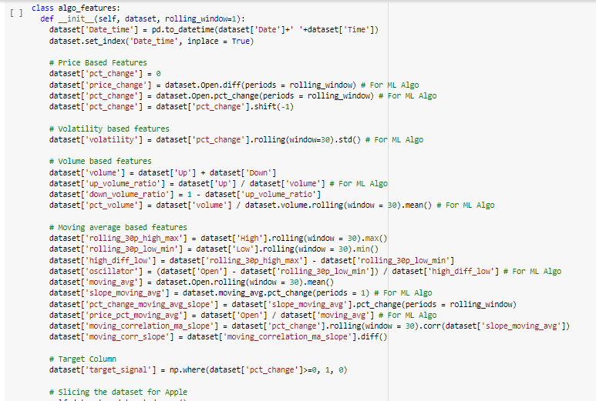
Data Clean up
Actions taken include
Read text
Created a dataframe of features for each stock using the class function
Features defined include
Percentage change
Price change
Volatility
Up-down ratio
Moving correlation
Oscillator
Slope moving average
more
Identified column to be predicted as target Signal which is derived from changes in percentage change column.

Slide 6
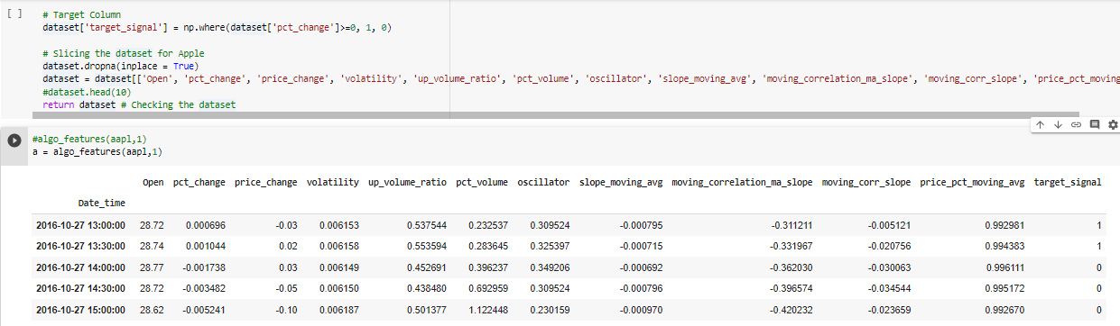
Data Clean up
Using the Percentage Change as one of the feature we calculated Target Signal:

Slide 7
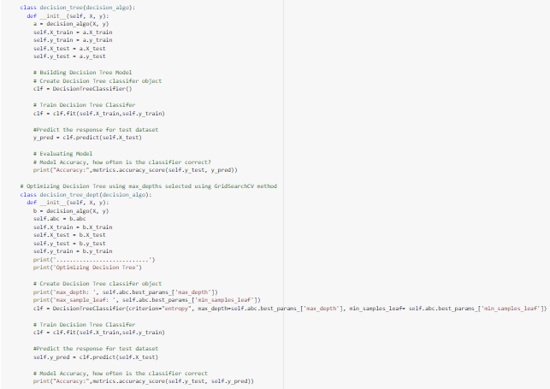
Model 1 –Decision Tree ML Algo
To create the algorithm, we defined functions to execute the following instructions:
Split data into Training and Testing sets
Create a dataframe to store model performance
Determine best parameters for the ML model using GridSearchCV library
Fit data into model
Make predictions
Further optimize model to increase accuracy
Provide information on accuracy level of prediction

Slide 8
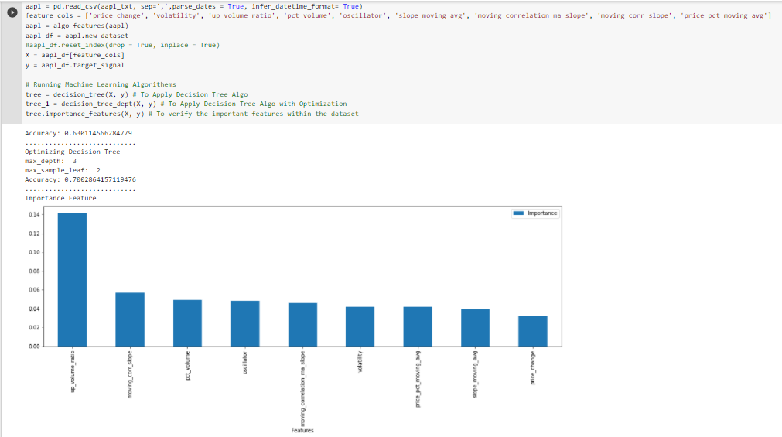
Running the Decision Tree ML Algo for Aapl
Accuracy level without optimization is 63%
Post optimization, accuracy improved to 70%
Top 4 best parameters identified include
Up-down volume
Moving correlation
Percentage change in volume
Oscillator

Slide 9
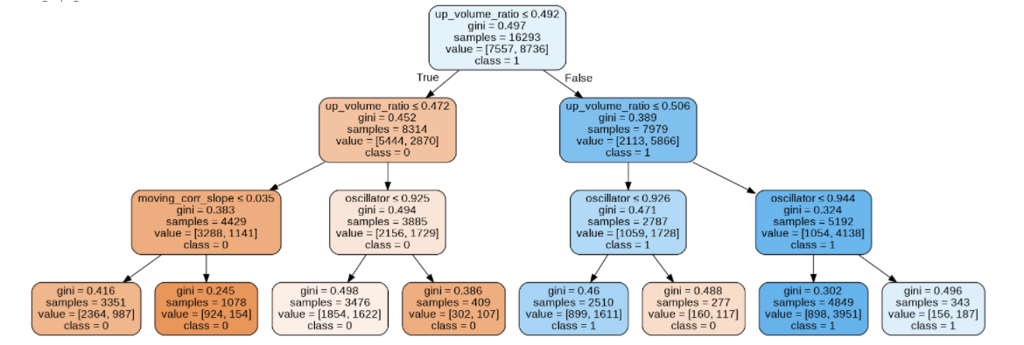
Model 1 –Decision Tree ML Algo – Model Use & Motivation
Decision tree ML Algo is a tree-based algorithm. Tree-based algorithms are part of supervised ML methods used for classification and regression problems that involve accessing risk, preventing fraud or fighting money laundering.
Decision trees are easy to represent, making complex models easy to interpret. Also useful in mapping non-linear relationship in data.
Require little or no data preparation and can handle data that is not normally distributed
Most importantly, it is also very robust against overfitting

Slide 10
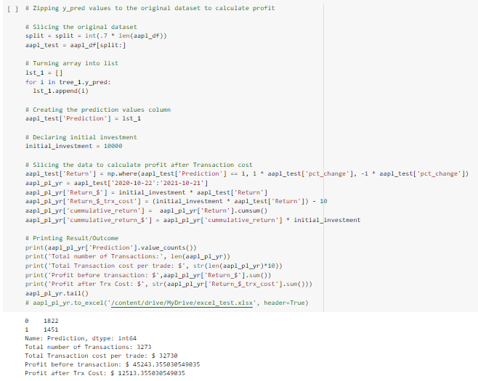
Accessing Profitability for Aapl
Assuming an initial investment of $10,000 over a one-year period
And $10 as transaction cost per trade.
The investment value before transaction cost from this model is estimated at ~$45,000.
With over 3000 transactions executed, profit net transaction costs is ~$12,000.

Slide 11
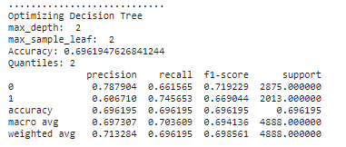
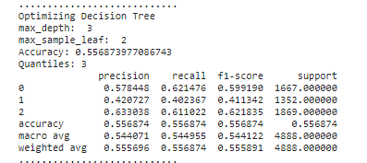
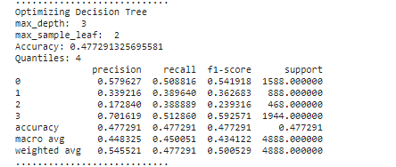
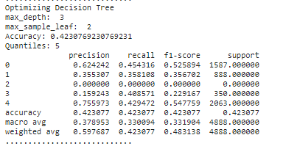
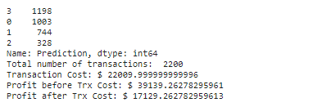
Application of Decision Tree ML on a Quantiles basis taken as Target Signal
We also carried out several iterations of the model to reduce transaction volume.
While profitability improved, accuracy fell considerably to 42%
We finally settled into the iteration with 4 quantiles, accuracy 48% which provided us with the lowest number of transactions and highest profitability of ~$17,000

Slide 12
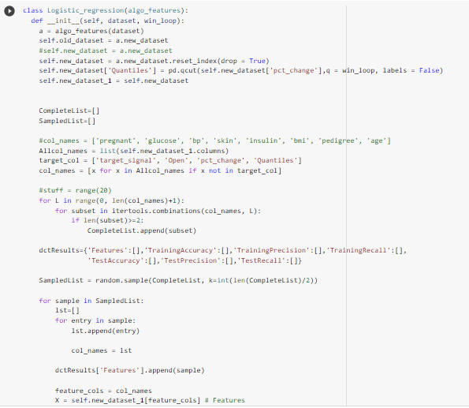
Model 2 –Logistic Regression ML Algo Model Motivation
Logistic Regression is a classical classifier. Together with sector vector machines can be used for fraud detection, lending decision and medical diagnosis. Can also be used to predict financial outcomes.
They are generally faster and can outperform decision trees especially with data with a large number of features and no noise.
It supports incremental learning via data streams and handles outliers better.
Outcomes are identified as labels which serve to categorize according to shared qualities and characteristics.

Slide 13
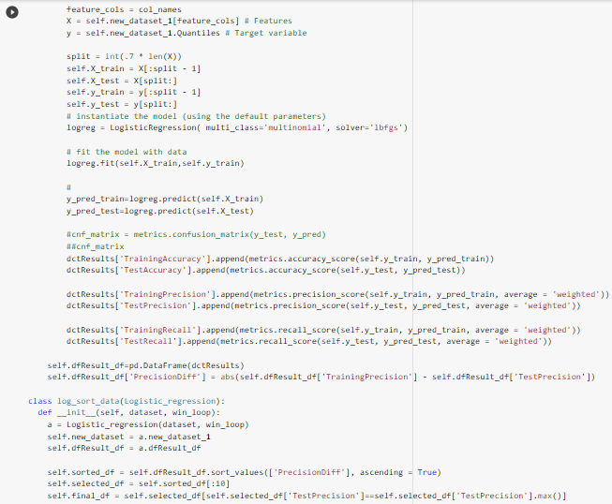
Model 2 –Logistic Regression ML Algo Model
In this model, we created an algorithm to randomly create all the features sample to determine the following:
To estimate the Test, Training Precision and recall, along with its accuracy
Which lead to determine the best feature sample based on the highest precision where difference between Training and Test data is not that much, to avoid imbalanced data as well.
Like the first model, we created a function that allowed us to do the following
separate the features from the target data
split our data into test data and train data
Fit the model using the train data
Make predictions
And evaluate accuracy

Slide 14
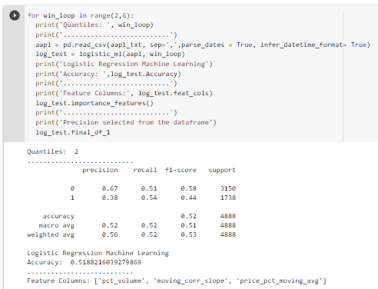
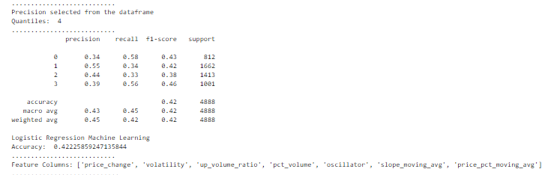
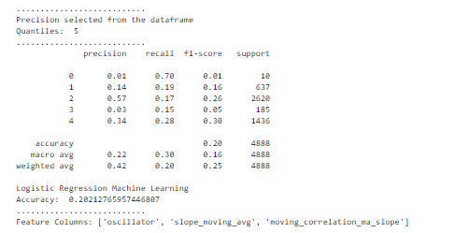
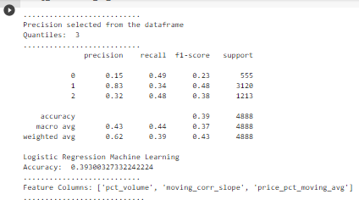
Ran Logistic regression with different Quantiles to see which one predicts with higher accuracy, precision and recall
With increasing quantiles, accuracy dropped from 52% to 20%.
We did not run profitability analysis on these numbers due to lower-than-expected accuracy numbers.

Slide 15
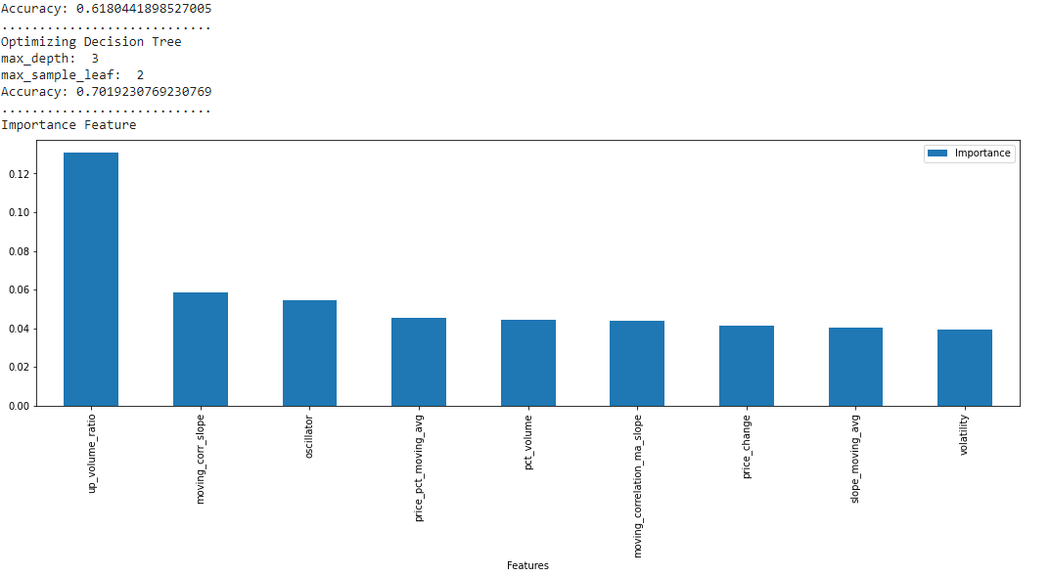
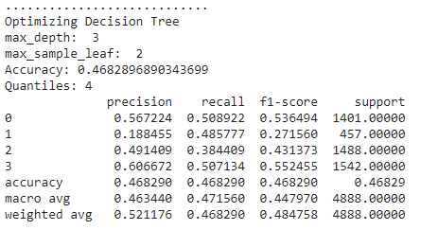


Results from Nvidia Stock with Decision tree
Binomial method
Accuracy level without optimization is 62%
Post optimization, accuracy improved to 70%
Profits with binomial target signal is about 39K
Profits with multinomial (Quantiles) is about 34K
Multinomial method
Binomial method
Multinomial method

Slide 16
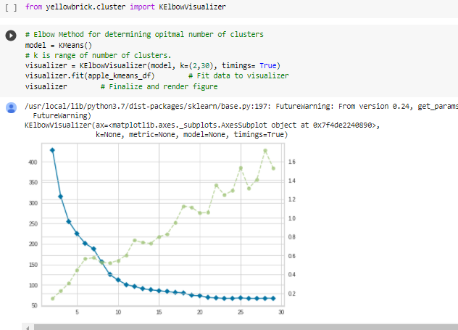
Model 3 –Cluster Analysis

Slide 17
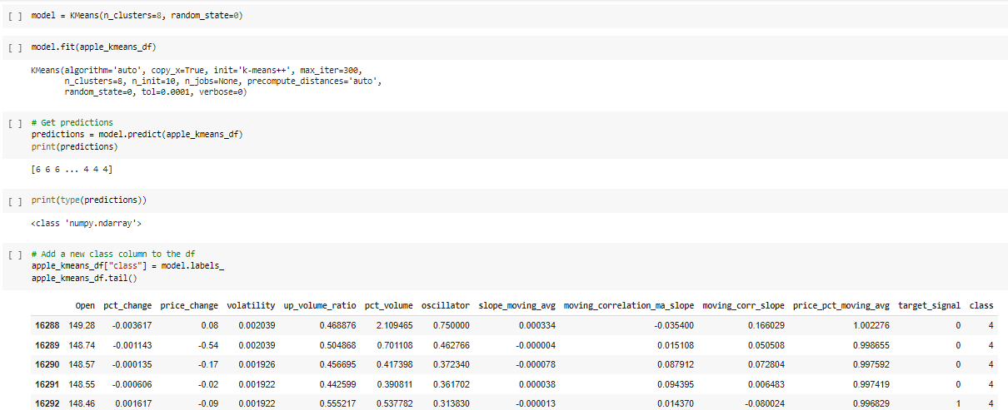
Model 3 –Cluster Analysis

Slide 18
Discussion
We were able to get good accuracy numbers from Decision tree ML Algo and was able to increase profitability with both binomial and multinomial method
On the other hand, the Logistic Regression model and cluster analysis model we also looked at did not provide us with a much better result most likely due to overfitting or nature of the data.
Data analyzed was only from two stocks (AAPL, NVDA)
Application of best feature selection was only done at Logistic regression side, and not at Decision tree which may have increased the overall profitability even more

Slide 19
Postmortem
Issues encountered include:
Further Automation is required to take the best possible outcome from the multinomial result and apply it in the overall trading perspective
Further Machine learning algorithm needs to be explored
Due to time constraint we were able to test the algo on two stocks only, but this may require further analysis on other stocks, and others forms of financial instruments
Integrating this program to an algo trading platform

Slide 20
Questions

